Slide 1
Introduction to image analysis
Adam Tyson
April 2018

Slide 2
Aims
Introduction to fundamental image analysis principles
Using ImageJ/FIJI (but everything is general)
Convert biological question into computational problem
Disclaimer:
Some parts will be very simple. Some parts won’t.
The aim is to help you understand image analysis for your PhD/postdoc/career, not to be able to use ImageJ by the end of the day.
Like anything, requires practice.
Email me whenever – adam.tyson@icr.ac.uk

Slide 3
Questions
Are you currently using microscopy or planning to?
Which system(s)?
Confocal/spinning disk
Multiphoton
High content (Celigo/Operetta/ImageXpress)
TIRF
Lightsheet
Any others?
Which analysis software?
A bit / no / lots of experience?
Any specific aims?

Slide 4
First (and most important lesson)
Sample
preparation
Test your analysis before you acquire data!
Data
Analysis
Biological information

Slide 5
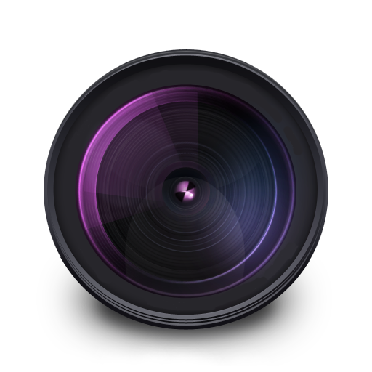
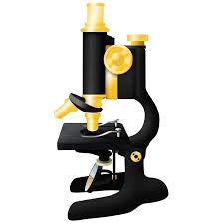






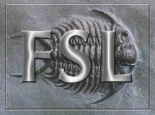



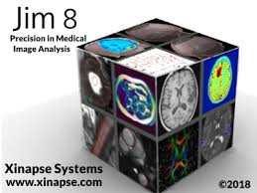






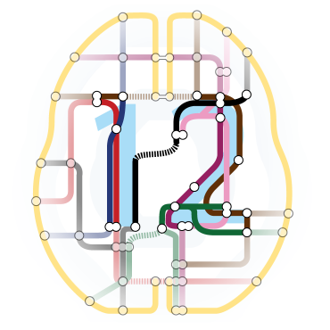
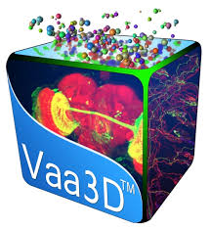
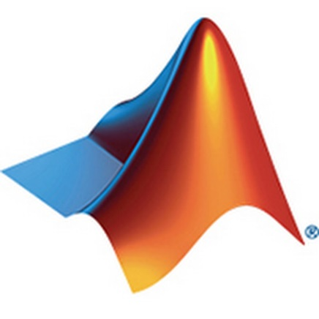


Software
Notes:
Lots of software. Not much point teaching a specific one, going to go through fundamental principles.

Slide 6
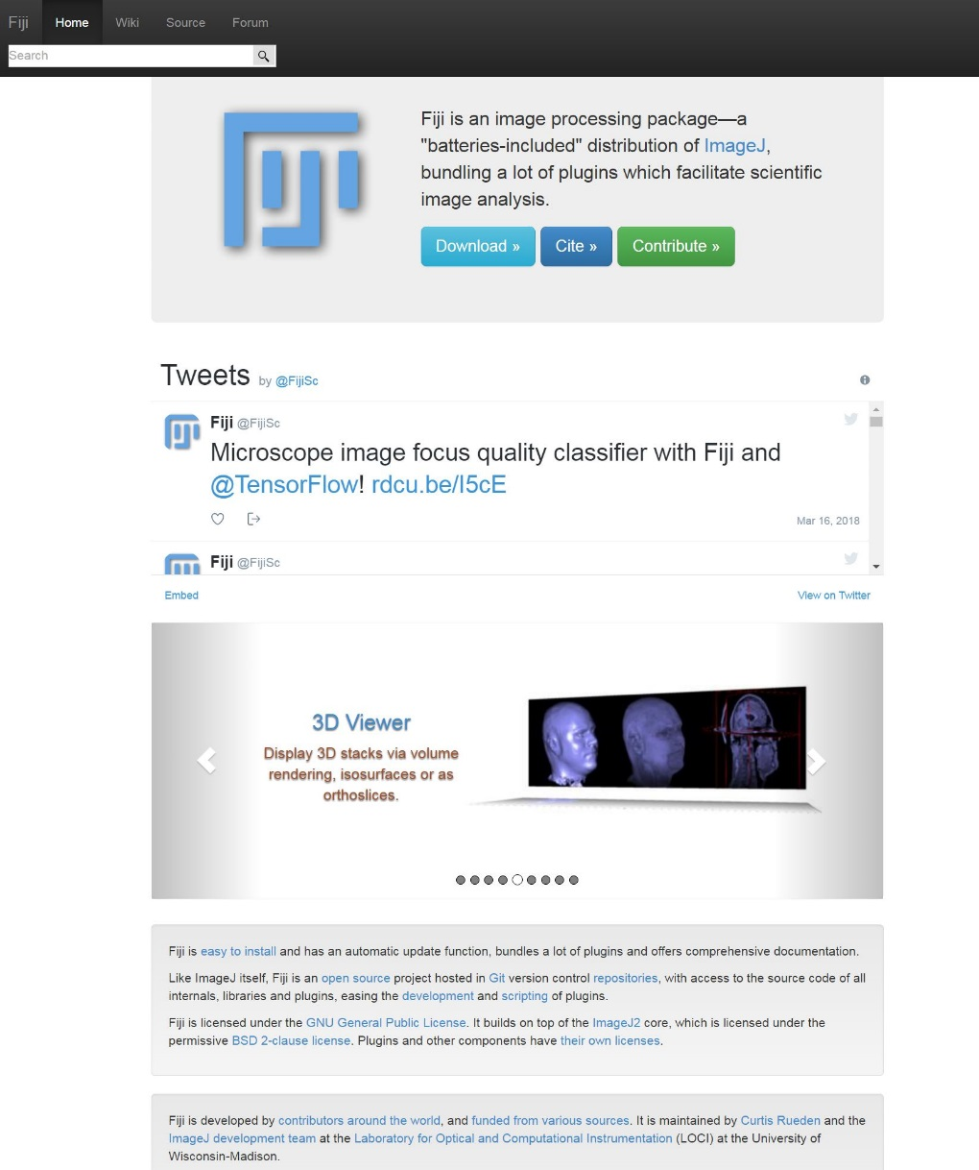
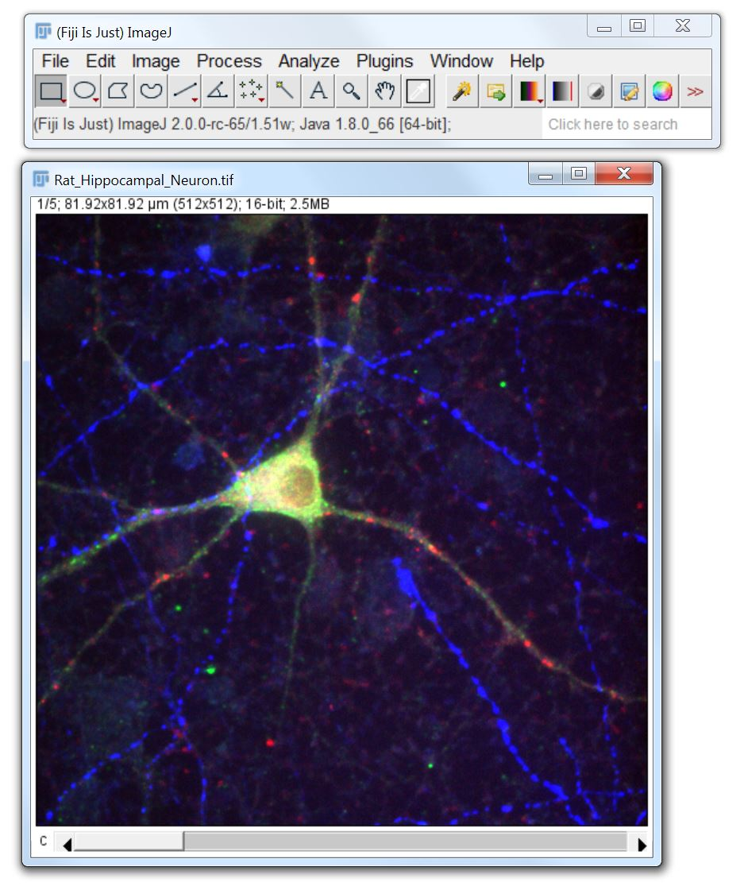
FIJI (FIJI is just ImageJ)
Free
Open source
Cross platform
Flexible
Huge community
https://fiji.sc/
http://forum.imagej.net/

Slide 7
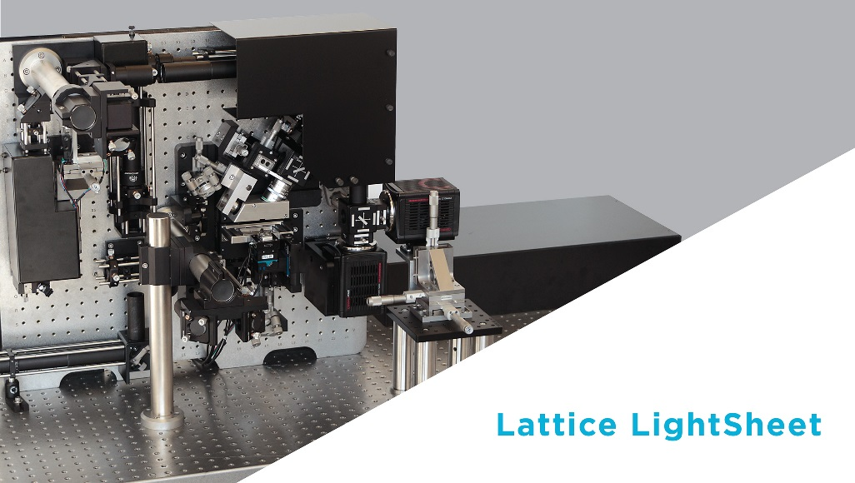
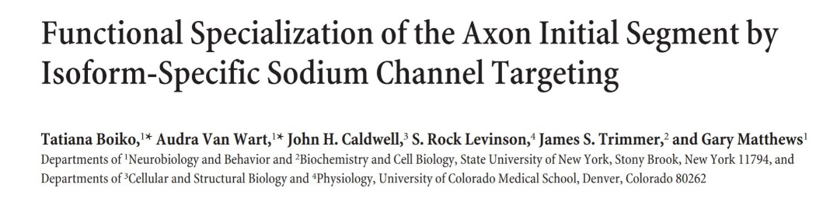
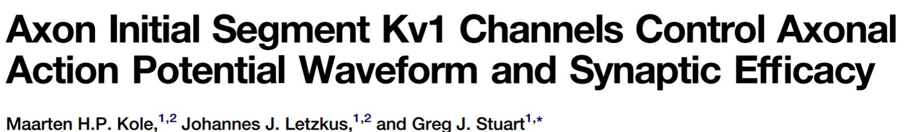
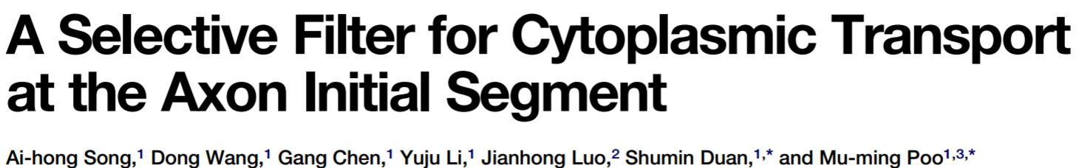
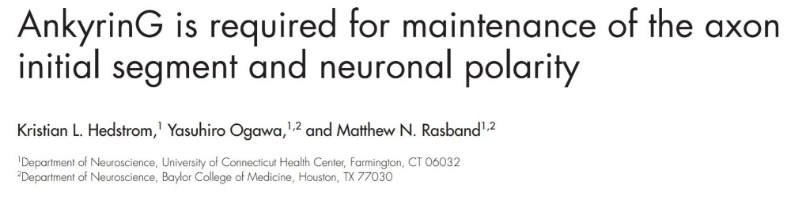
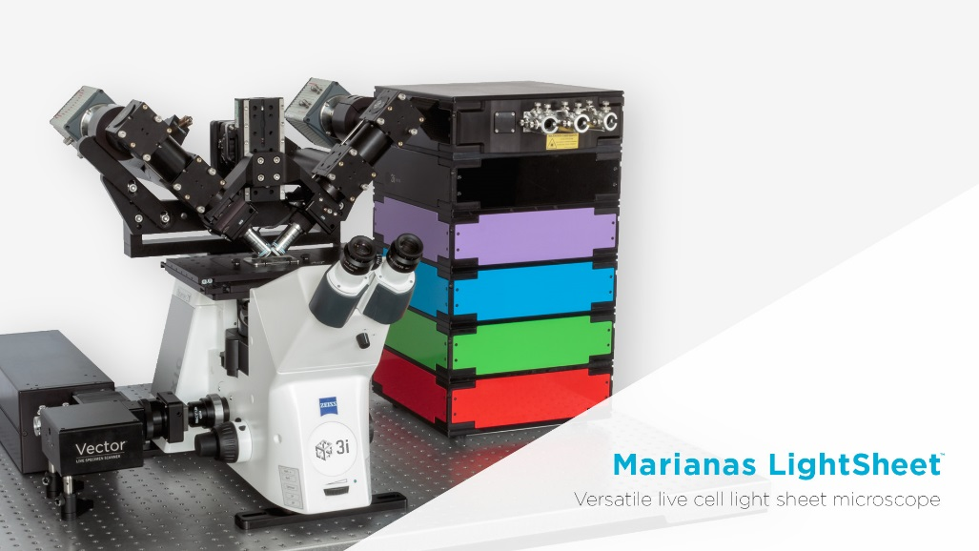
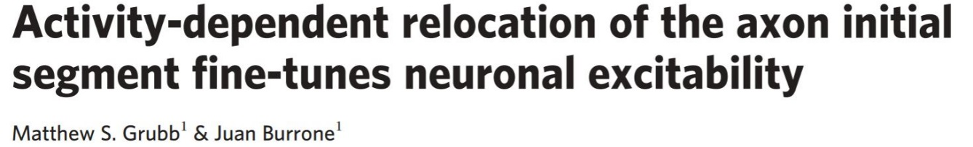
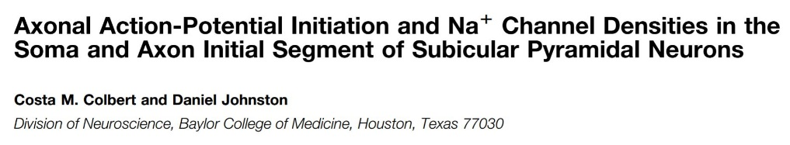
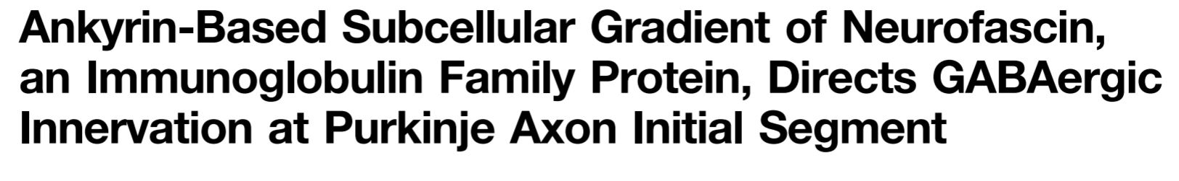
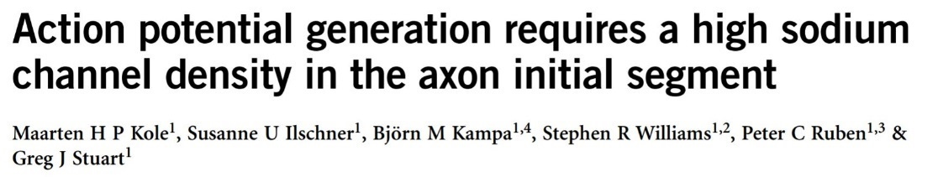
Why computational image analysis?
Quantity of data (TB’s per day)
Reproducibility, comparison
Notes:
Lots of data, can’t analyse manually. Inspection of data doesn’t help when comparing lots of studies.

Slide 8

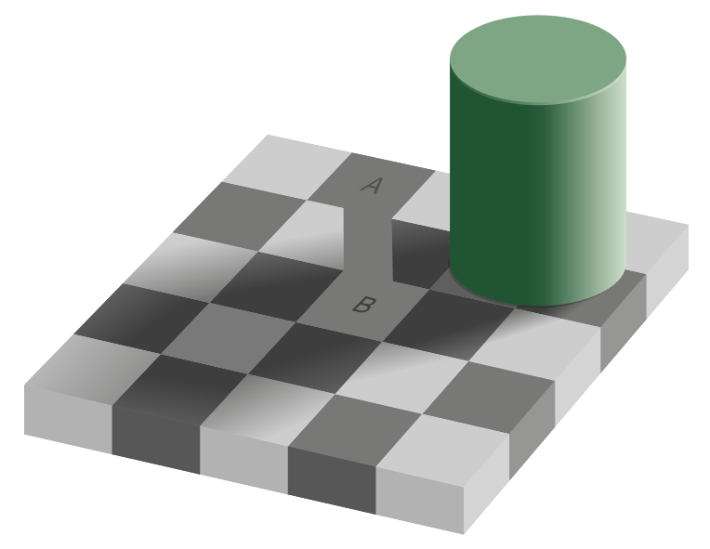

Why computational image analysis?
Visual system relies heavily on context and relative changes.
Checker shadow illusion, Edward Adelson 1995.
Jastrow illusion, Joseph Jastrow (and others), 1892.
Notes:
Most importantly – eye is very easy to fool.

Slide 9
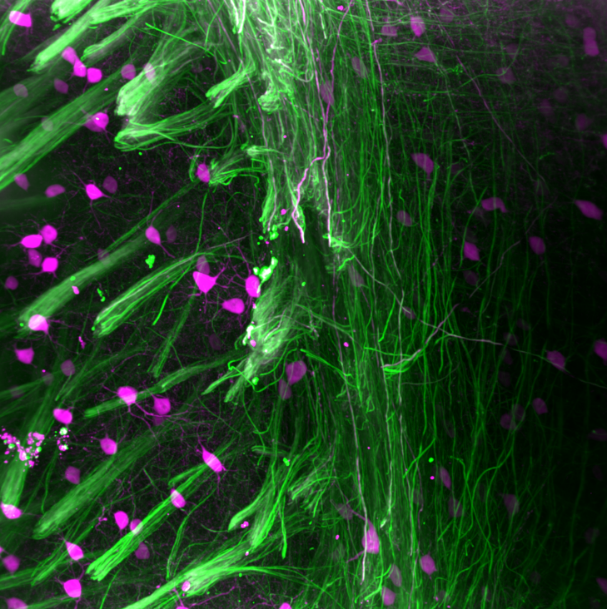
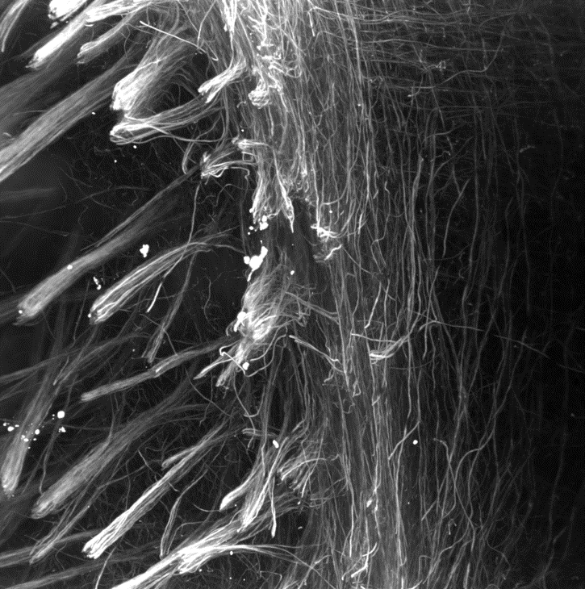
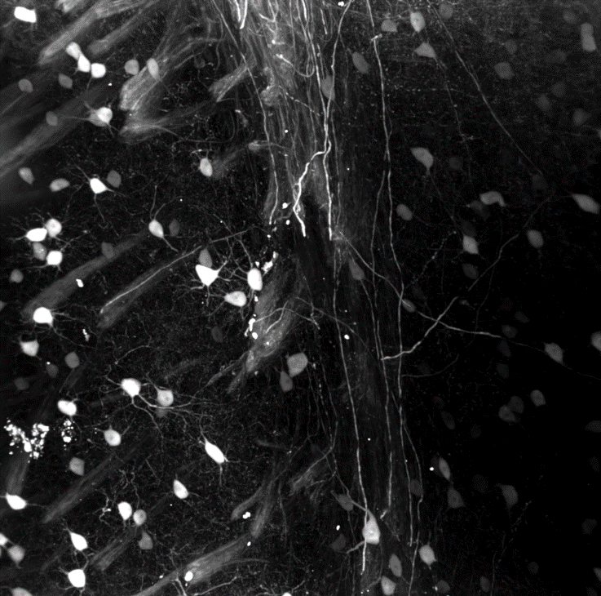
Nearly all microscopy images aren’t colour

Slide 10

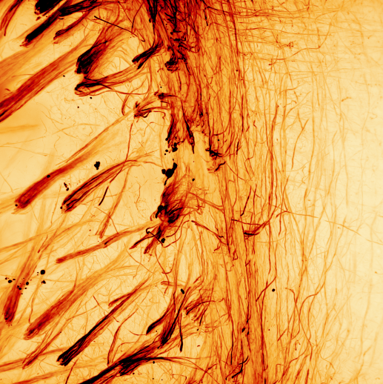
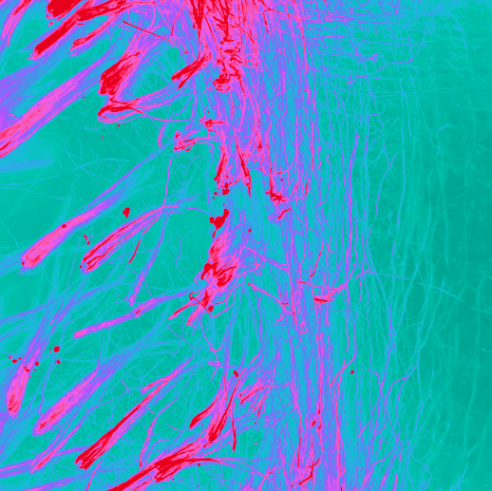
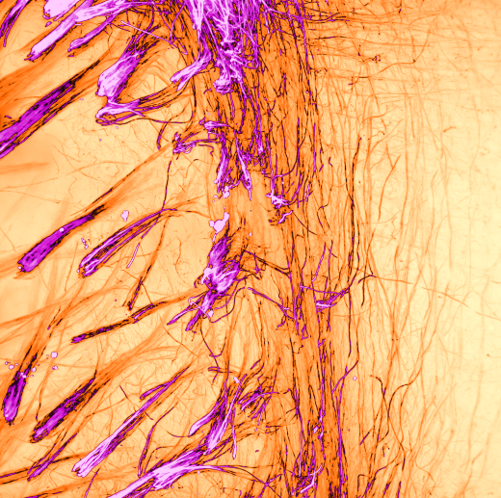
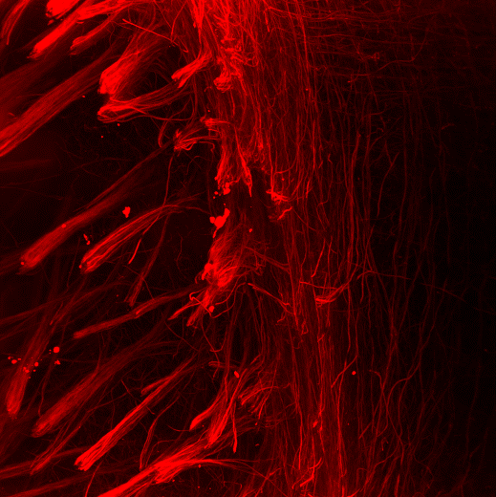
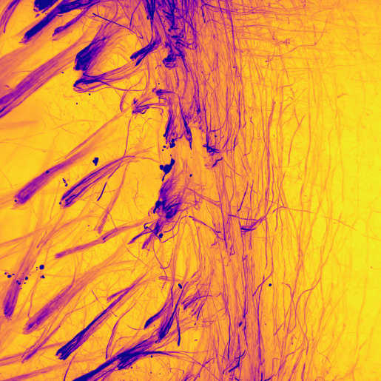
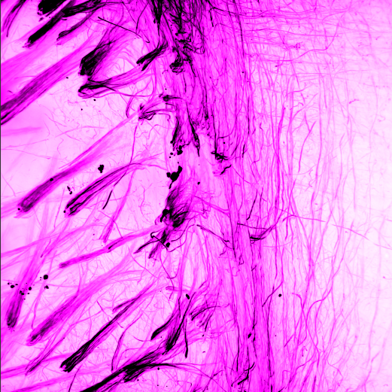
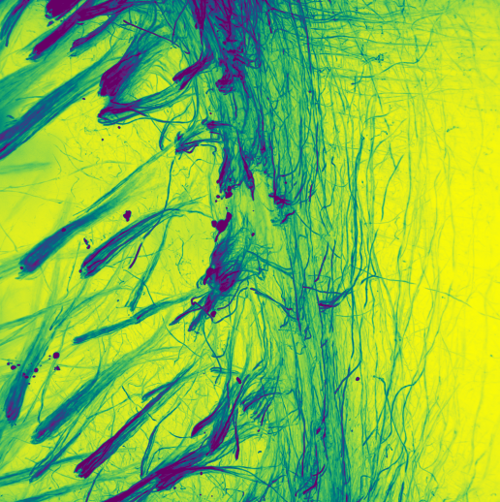
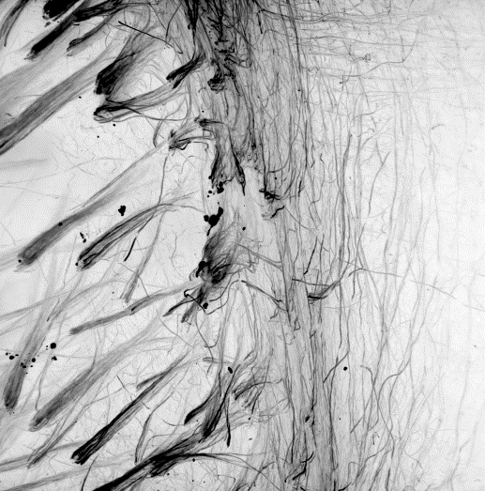
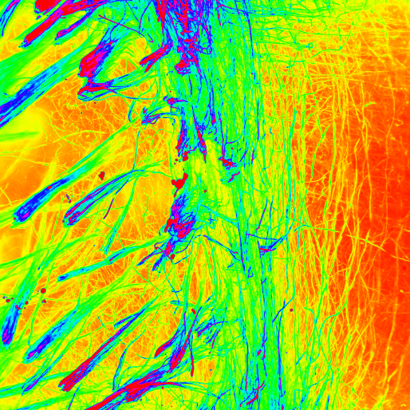
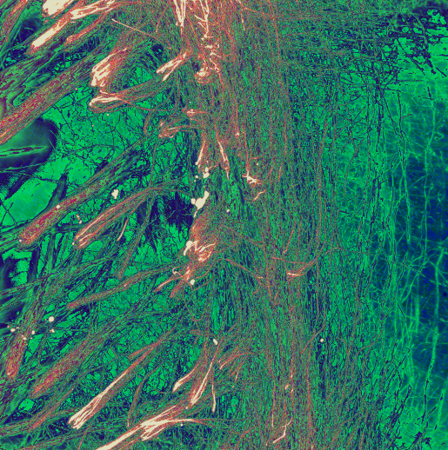
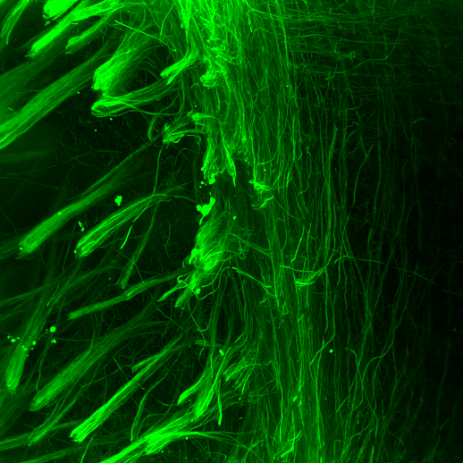
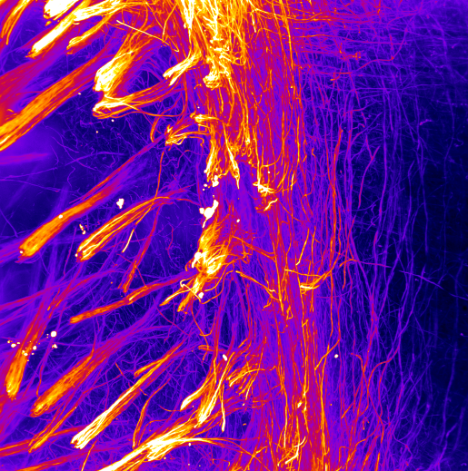
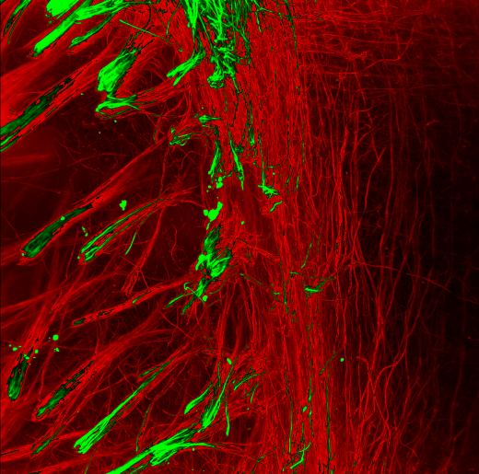
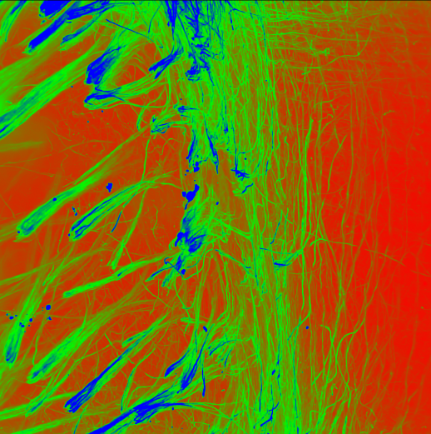
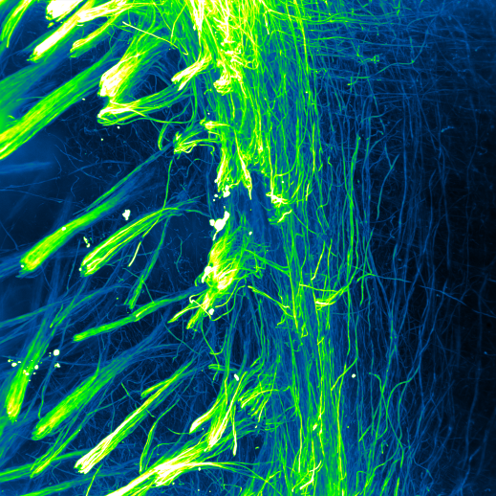
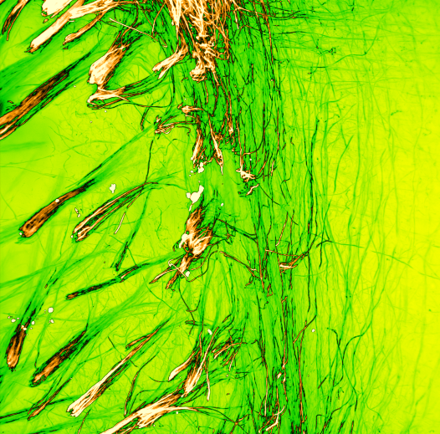
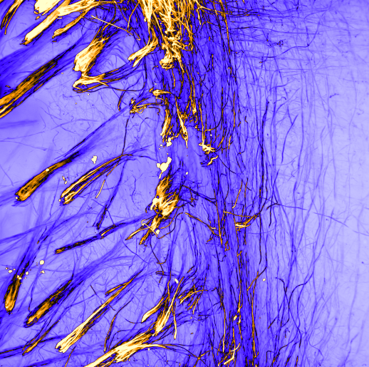
Lookup tables (LUTs)

Slide 11
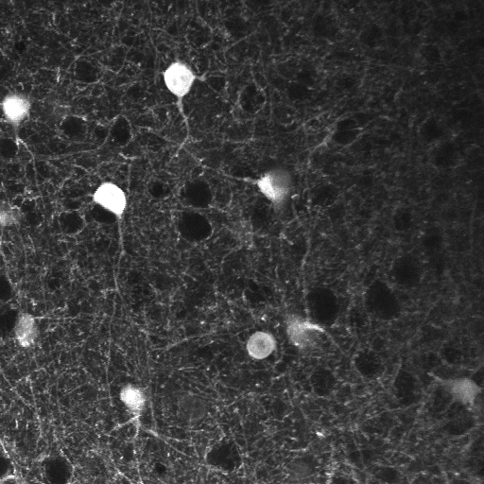
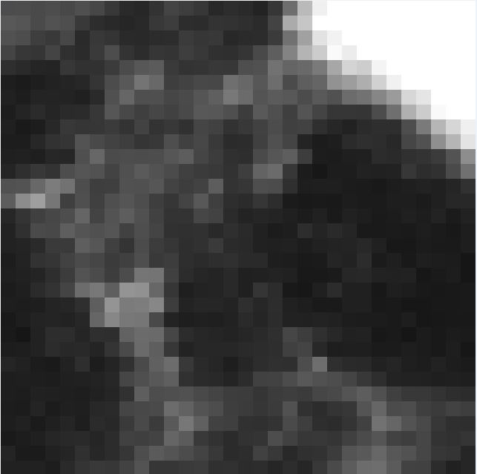

Images are arrays of numbers
78 | 64 | 71 | 57 | 43 | 44
86 | 93 | 69 | 60 | 48 | 46
75 | 64 | 57 | 59 | 55 | 62
70 | 65 | 69 | 85 | 56 | 54
54 | 68 | 88 | 63 | 46 | 43
51 | 51 | 74 | 66 | 43 | 35
Notes:
Important to remember that images are just arrays of numbers, and all image processing is mathematical operations upon these numbers.

Slide 12
More complicated images are still arrays of numbers
2D
78 | 64 | 71 | 57 | 43 | 44
86 | 93 | 69 | 60 | 48 | 46
75 | 64 | 57 | 59 | 55 | 62
70 | 65 | 69 | 85 | 56 | 54
54 | 68 | 88 | 63 | 46 | 43
51 | 51 | 74 | 66 | 43 | 35
Notes:
Important to remember that images are just arrays of numbers, and all image processing is mathematical operations upon these numbers.

Slide 13
More complicated images are still arrays of numbers
RGB
2D
Time-lapse
3D RGB
3D
3D time-lapse
3D RGB time-lapse
Notes:
Important to remember that images are just arrays of numbers, and all image processing is mathematical operations upon these numbers.

Slide 14
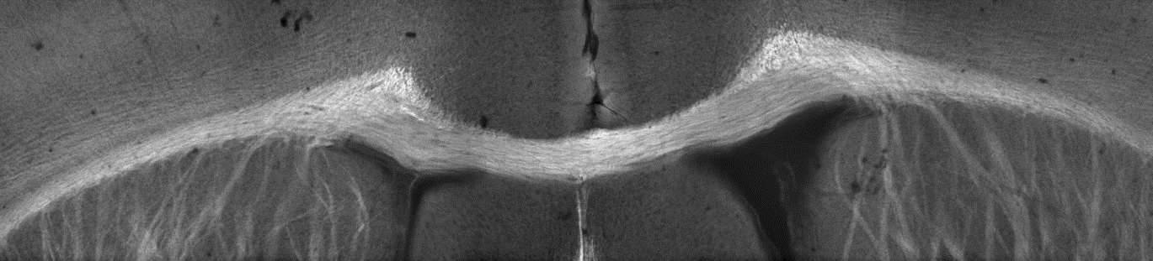

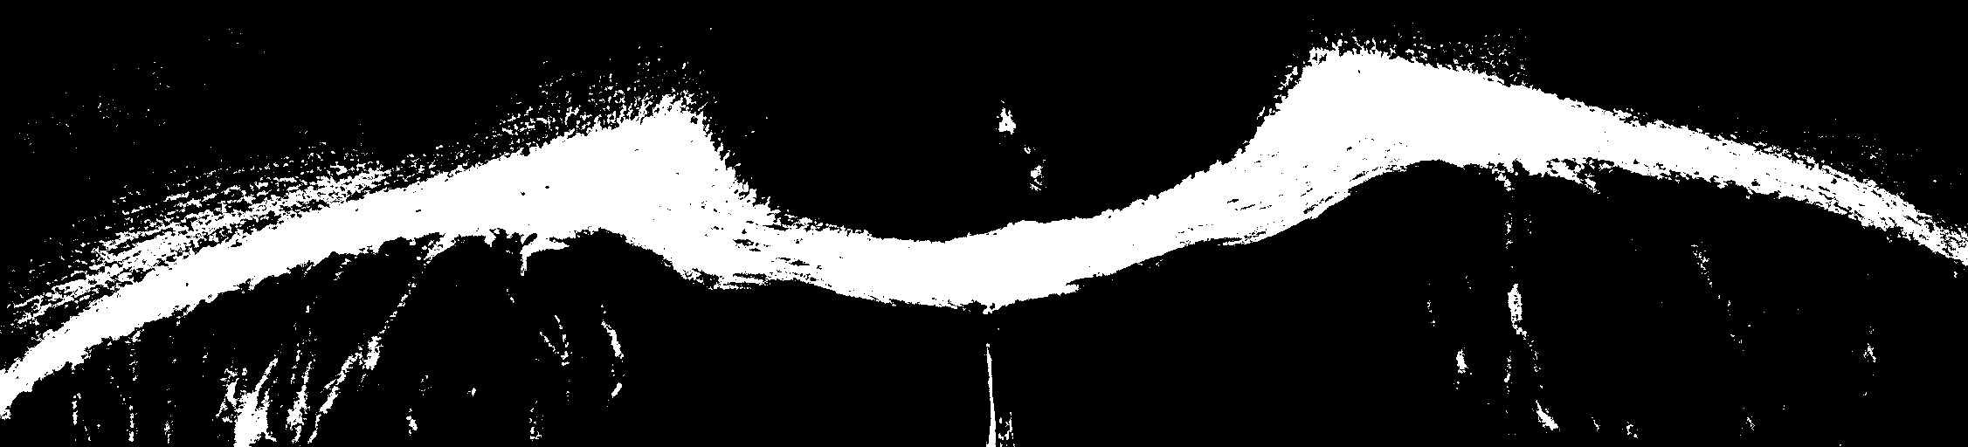
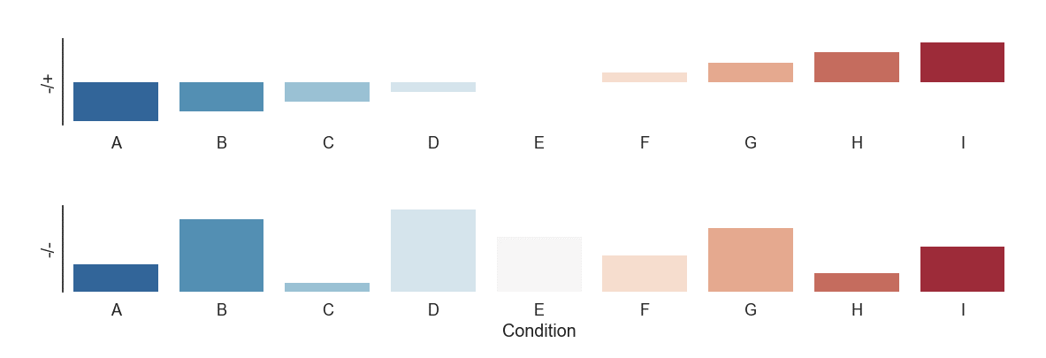
Image processing vs analysis
Volume
Shape
Texture
Notes:
During image analysis, lots of the work will be image processing, i.e. getting the image ready to be analysed.

Slide 15
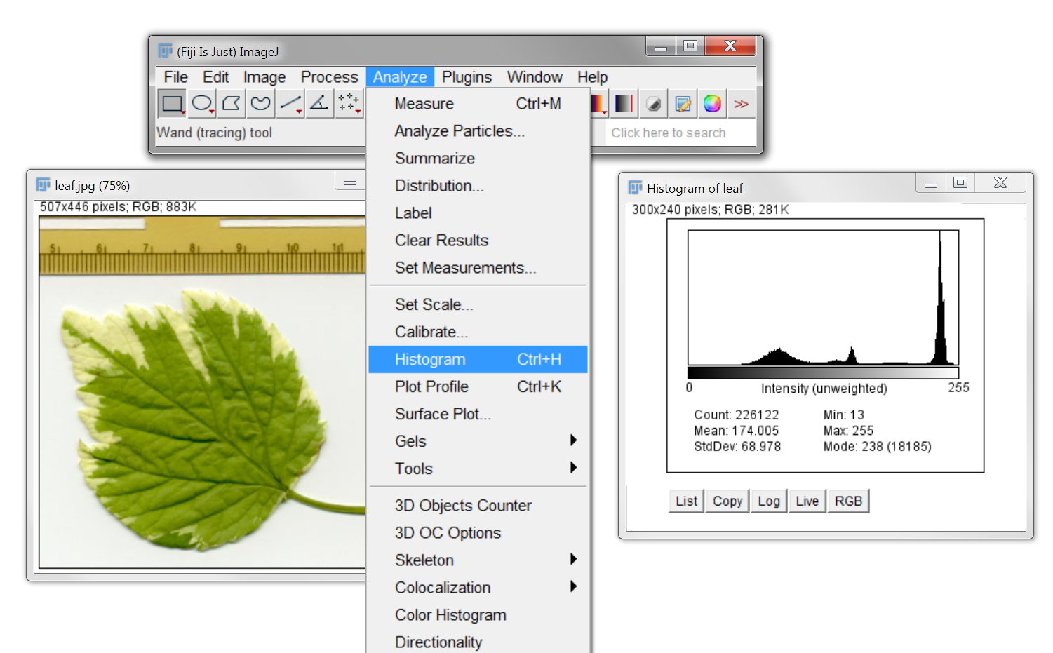
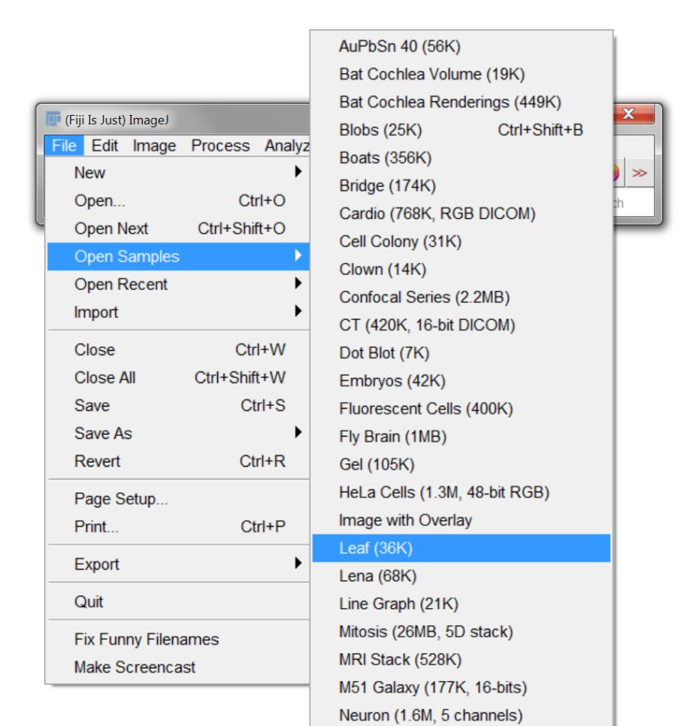
Histogram
Open any sample image
Open histogram
Notes:
Histogram shows how many pixels are of each possible intensity,

Slide 16
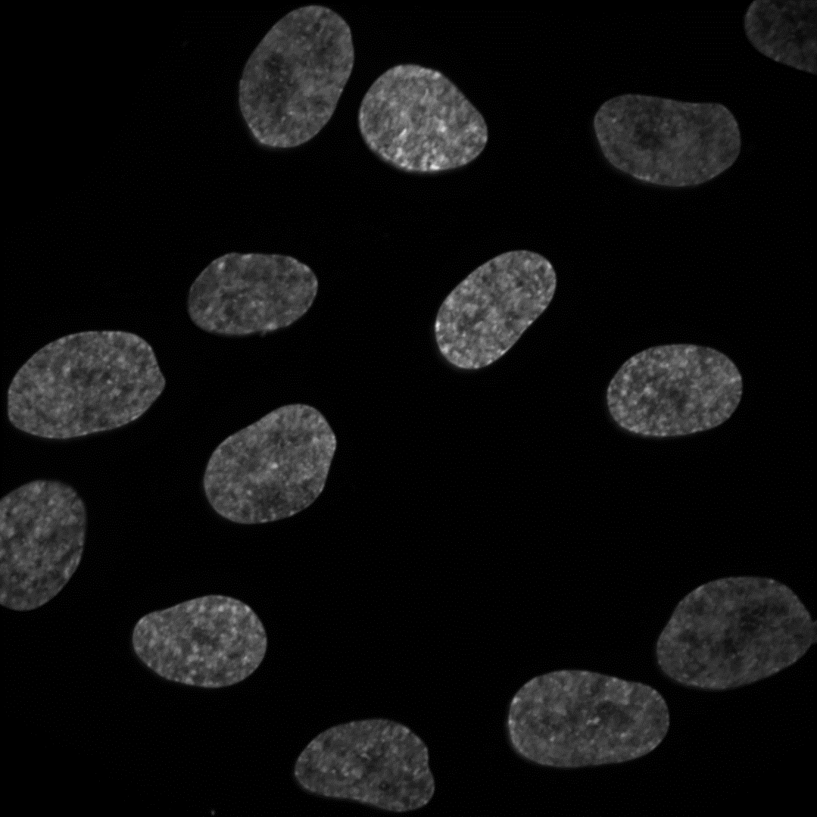
Thresholding
Threshold (κ)
Notes:
To perform a simple threshold, pick a point on the histogram. All pixels below a point belong to one class, and all pixels above it belong to the other.

Slide 17
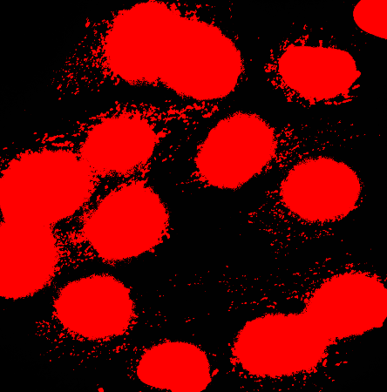
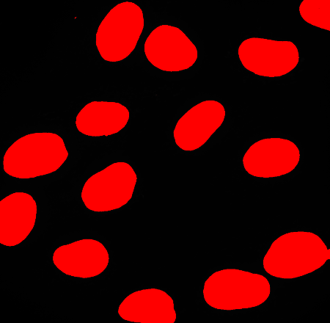




Thresholding
$$k$$
$$k$$
$$k$$
Notes:
Choosing the right value for this threshold is obviously important. Too high, and features of interest won’t be detected. Too low, and other structures in the image will be detected too.

Slide 18


Thresholding – try it out
Open DAPI.tif
Threshold

Slide 19


Manual threshold - problems
DAPI.tif
DAPI_2.tif

Slide 20


Automatic thresholding – Equal masses
Ideal case
Real case
$$k$$
$$k$$

Slide 21









Automatic thresholding – Otsu’s method
Minimise within class variance (σ_{W})
Maximise between class variance (σ_{B})
$$σ_{W1}$$
$$σ_{W2}$$
$$σ_{W1}$$
$$σ_{W2}$$
$$σ_{B}$$
$$σ_{B}$$
$$k$$
$$k$$
$$\max_{k}{(\frac{{σ_{{W1}_{t}} + σ}_{{W2}_{k}}}{σ_{B_{k}}})}$$
Otsu (1979) IEEE Transactions on Systems, Man and Cybernetics. Vol SMC-9, No 1, p62

Slide 22

Unimodal thresholding – Rosin’s method
Use shape of distribution to find threshold
$$k$$
Rosin (2001) Pattern Recognition. Vol 34, No 11, p2083

Slide 23

Try it out – Otsu’s method
Otsu (1979) IEEE Transactions on Systems, Man and Cybernetics. Vol SMC-9, No 1, p62

Slide 24

Many, many other methods
Kapur et al. (1985) Graphical Models and Image Processing Vol 29, No 3, p273

Slide 25


Not always that simple …
Open DAPI_3.tif
Pick a threshold
vs

Slide 26


Background subtraction – e.g. vignetting
Sample
Microscope
Image

Slide 27
Background subtraction – e.g. vignetting
How to calculate??

Slide 28

Estimate background – Gaussian smoothing
Seems arbitrary, but smoothing is often a key step in image processing
Try a value of 200 pixels

Slide 29


Estimate background – Gaussian smoothing
May need to adjust brightness

Slide 30



Estimate background

Slide 31



Now try thresholding
Better, but not great

Slide 32

Morphological operations
Processing of (usually binary) images based on shape

Slide 33



Morphological operations
Try on the previous example
Dilated and closed
Thresholded
Eroded

Slide 34



Watershed – separate objects
From the previous example
Notes:
Basic implementation in ImageJ – but often requires a lot of tweaking if you don’t have two perfectly circular objects.

Slide 35


Watershed
Negative intensity profile
Distance transform
Watershed

Slide 36



Filters - Gaussian
Large kernel (200 pix)
Correct inhomogeneous illumination

Slide 37


Filters - Gaussian
Small kernel (8 pix)
Smooth intensity variations for thresholding

Slide 38



Filters - Gaussian
Open foci.tif & try thresholding
Apply Gaussian smoothing (use preview) & try again
vs

Slide 39








Filters - Gradient
Edge detection
Approximate derivative:
The Sobel operator
$$f(x)$$
$$G_{x}=$$
$$\begin{matrix}+1 & 0 & −1 \\ +2 & 0 & −2 \\ +1 & 0 & −1\end{matrix}$$
*
$$I$$
$$\frac{df}{dx}$$
$$\begin{matrix}+1 & +2 & +1 \\ 0 & 0 & 0 \\ −1 & −2 & −1\end{matrix}$$
$$G_{y}=$$
*
$$I$$

Slide 40










Filters - Gradient
$$\begin{matrix}−1 & 0 & +1\end{matrix}$$
$$\begin{matrix}+1 & 0 & −1\end{matrix}$$
$$\begin{matrix}+1 \\ 0 \\ −1\end{matrix}$$
$$\begin{matrix}−1 \\ 0 \\ +1\end{matrix}$$

Slide 41


Filters - Gradient
Combine

Slide 42
Boolean image mathematics
AND
OR
XOR

Slide 43





Boolean image mathematics - masking
PV.tif
PV_DAPI.tif
PV_seg.tif

Slide 44
First (and most important lesson) – again!
Sample
preparation
Test your analysis before you acquire data!
Data
Analysis
Biological information

Slide 45
Deconvolution
Sample
Blurred
Blurred & noisy
PSF
Noise
?

Slide 46
Deconvolution – how?
PSF
Image
Constrained iterative deconvolution
e.g. Richardson-Lucy
Operation
Convolve with PSF
Convolved
estimate
Raw Image
Estimate
Deconvolved
Compare with raw
Improve estimate
Raw Image
Lucy (1974) The Astronomical Journal. Vol 79, No 6 p745
Richardson (1972) Journal of the Optical Society of America, Vol 62, No 1, p55

Slide 47



Deconvolution – try it out
DeconvolutionLab2 (already installed)
Drag and drop
CElegans-FITC.tif
PSF-CElegans-FITC.tif
C. Elegans embryo - microtubules
Sage et al. (2017) Methods. Vol 115, p28
http://bigwww.epfl.ch/deconvolution/deconvolutionlab2/

Slide 48


Deconvolution – try it out (hopefully)
Deconvolution is computationally intense – may be very slow on these machines
Try “Regularized Inverse Filter”
Richardson-Lucy – start with 10 iterations - compare
http://bigwww.epfl.ch/deconvolution/deconvolutionlab2/

Slide 49
Deconvolution – notes
GIGA – Garbage In, Garbage Out
Not always necessary
Only an estimate of fluorophore distribution
100’s of algorithms and options – try them out
Can be very slow
Requires a good quality measured PSF (estimated PSF’s can work for standard microscopes)
Routine to measure each day on light-sheet systems (e.g. lattice)

Slide 50

Machine Learning
Open CHO.tif
Often intensity alone can’t be used for segmentation
Need “context”
Train the computer to “recognize” structures

Slide 51

Machine Learning
Try to threshold!

Slide 52


Machine Learning – Trainable Weka Segmentation

Slide 53

Machine Learning – Trainable Weka Segmentation

Slide 54








Machine Learning – Trainable Weka Segmentation
Lots of training data
Choose features carefully
Will be slow!
iLastik

Slide 55



Analysis (rather than processing)
Measure segmented objects

Slide 56


Analysis
Measure other objects
Draw, then measure

Slide 57


Analysis
Multiple objects – ROI manager

Slide 58



Analysis – 3D

Slide 59

Macros - record
Automated
Quicker
Reproducible (sharing)
Less chance for bias/mistakes
Works with most ImageJ plugins
No coding required (but possible)

Slide 60


Macros – edit & run
Use comments (lines starting with “//”) for notes/explanations

Slide 61
How to make your analysis easier – plan!
Use the correct method
Widefield
Confocal
Multiphoton
TIRF
Super resolution (PALM/STORM/SRRF)
Light sheet (iSPIM/diSPIM/Lattice)
Something else – flow cytometry, biochemistry?
Choose dyes carefully (SNR!)
mNeonGreen vs EGFP
Alexa 488 vs FITC

Slide 62


Resolution
Resolution depends on:
Wavelength of light
Refractive index of media (n)
NA of objective
(Width of light sheet)
$$Lateral resolution= \frac{0.51λ_{ex}}{NA}$$
$$Axial resolution= \frac{0.88λ_{ex}}{n−\sqrt{n^{2} −{NA}^{2}}}$$
Nyquist theorem
Sampling frequency (how many pixels) should be ≤ resolution
Modern acquisition software will do this for you.

Slide 63


Resolution – However!
What do you want to image?
15.4 pix μm⁻¹
0.916 pix μm⁻¹
Same information – 300 x less data
Also maybe quicker and more gentle

Slide 64


Resolution – 3D
If you want to analyse in 3D:
Isotropic resolution
3D
2D

Slide 65
Note – 3D analysis
Analysis almost always exactly the same as 2D:
Takes longer
Need to view in 3D to check
3D not necessarily supported by software package

Slide 66
Resolution – temporal

Slide 67
Resolution – temporal
Accurate sampling vs photobleaching & data size

Slide 68



Signal to noise ratio (SNR)
High resolution
Low resolution
Resolution irrelevant if you can’t detect structures of interest
High SNR
Contrast often the most important aspect of a good image
Low SNR

Slide 69


Analysis as a method
Observed widefield image
“True” image

Slide 70
Analysis as a method
Observed widefield image
STORM/PALMaquisition
“True” image
STORM/PALM

Slide 71
Analysis as a method
Observed widefield image
STORM/PALMaquisition
“True” image
Reconstructed image
Localised fluorophores
STORM/PALM

Slide 72
First (and most important lesson) – again!
Sample
preparation
Test your analysis before you acquire data!
Data
Analysis
Biological information

Slide 73
Any other courses?
General – more advanced
3D
Big datasets
Lightsheet processing
Super resolution
Tracking
Writing custom scripts – MATLAB / Python etc
Anything else?

Slide 74
Introduction to image analysis
Adam Tyson
April 2018

Slide 75
Aims
Introduction to fundamental image analysis principles
Using ImageJ/FIJI (but everything is general)
Convert biological question into computational problem

Slide 76
Aims
Introduction to fundamental image analysis principles
Using ImageJ/FIJI (but everything is general)
Convert biological question into computational problem
Disclaimer:
Some parts will be very simple. Some parts won’t.
The aim is to help you understand image analysis for your PhD/postdoc/career, not to be able to use ImageJ by the end of the day.
Like anything, requires practice.

Slide 77
Aims
Introduction to fundamental image analysis principles
Using ImageJ/FIJI (but everything is general)
Convert biological question into computational problem
Disclaimer:
Some parts will be very simple. Some parts won’t.
The aim is to help you understand image analysis for your PhD/postdoc/career, not to be able to use ImageJ by the end of the day.
Like anything, requires practice.
Email me whenever – adam.tyson@icr.ac.uk

Slide 78
Questions

Slide 79
Questions
Are you currently using microscopy or planning to?

Slide 80
Questions
Are you currently using microscopy or planning to?
Which system(s)?
Confocal/spinning disk
Multiphoton
High content (Celigo/Operetta/ImageXpress)
TIRF
Lightsheet
Any others?

Slide 81
Questions
Are you currently using microscopy or planning to?
Which system(s)?
Confocal/spinning disk
Multiphoton
High content (Celigo/Operetta/ImageXpress)
TIRF
Lightsheet
Any others?
Which analysis software?

Slide 82
Questions
Are you currently using microscopy or planning to?
Which system(s)?
Confocal/spinning disk
Multiphoton
High content (Celigo/Operetta/ImageXpress)
TIRF
Lightsheet
Any others?
Which analysis software?
A bit / no / lots of experience?

Slide 83
Questions
Are you currently using microscopy or planning to?
Which system(s)?
Confocal/spinning disk
Multiphoton
High content (Celigo/Operetta/ImageXpress)
TIRF
Lightsheet
Any others?
Which analysis software?
A bit / no / lots of experience?
Any specific aims?

Slide 84
First (and most important lesson)
Sample
preparation
Test your analysis before you acquire data!
Data
Analysis
Biological information

Slide 85
Software
Notes:
Lots of software. Not much point teaching a specific one, going to go through fundamental principles.

Slide 86
FIJI (FIJI is just ImageJ)
https://fiji.sc/
http://forum.imagej.net/

Slide 87
FIJI (FIJI is just ImageJ)
Free
Open source
Cross platform
Flexible
Huge community
https://fiji.sc/
http://forum.imagej.net/

Slide 88
Why computational image analysis?
Notes:
Lots of data, can’t analyse manually. Inspection of data doesn’t help when comparing lots of studies.

Slide 89
Why computational image analysis?
Quantity of data (TB’s per day)
Notes:
Lots of data, can’t analyse manually. Inspection of data doesn’t help when comparing lots of studies.

Slide 90
Why computational image analysis?
Quantity of data (TB’s per day)
Reproducibility, comparison
Notes:
Lots of data, can’t analyse manually. Inspection of data doesn’t help when comparing lots of studies.

Slide 91
Why computational image analysis?
Visual system relies heavily on context and relative changes.
Checker shadow illusion, Edward Adelson 1995.
Notes:
Most importantly – eye is very easy to fool.

Slide 92
Why computational image analysis?
Visual system relies heavily on context and relative changes.
Checker shadow illusion, Edward Adelson 1995.
Notes:
Most importantly – eye is very easy to fool.

Slide 93
Why computational image analysis?
Visual system relies heavily on context and relative changes.
Checker shadow illusion, Edward Adelson 1995.
Jastrow illusion, Joseph Jastrow (and others), 1892.
Notes:
Most importantly – eye is very easy to fool.

Slide 94
Nearly all microscopy images aren’t colour

Slide 95
Nearly all microscopy images aren’t colour

Slide 96
Nearly all microscopy images aren’t colour

Slide 97
Lookup tables (LUTs)

Slide 98
Images are arrays of numbers
78 | 64 | 71 | 57 | 43 | 44
86 | 93 | 69 | 60 | 48 | 46
75 | 64 | 57 | 59 | 55 | 62
70 | 65 | 69 | 85 | 56 | 54
54 | 68 | 88 | 63 | 46 | 43
51 | 51 | 74 | 66 | 43 | 35
Notes:
Important to remember that images are just arrays of numbers, and all image processing is mathematical operations upon these numbers.

Slide 99
More complicated images are still arrays of numbers
2D
78 | 64 | 71 | 57 | 43 | 44
86 | 93 | 69 | 60 | 48 | 46
75 | 64 | 57 | 59 | 55 | 62
70 | 65 | 69 | 85 | 56 | 54
54 | 68 | 88 | 63 | 46 | 43
51 | 51 | 74 | 66 | 43 | 35
Notes:
Important to remember that images are just arrays of numbers, and all image processing is mathematical operations upon these numbers.

Slide 100
More complicated images are still arrays of numbers
2D
Notes:
Important to remember that images are just arrays of numbers, and all image processing is mathematical operations upon these numbers.

Slide 101
More complicated images are still arrays of numbers
RGB
2D
Notes:
Important to remember that images are just arrays of numbers, and all image processing is mathematical operations upon these numbers.

Slide 102
More complicated images are still arrays of numbers
RGB
2D
3D
Notes:
Important to remember that images are just arrays of numbers, and all image processing is mathematical operations upon these numbers.

Slide 103
More complicated images are still arrays of numbers
RGB
2D
Time-lapse
3D
Notes:
Important to remember that images are just arrays of numbers, and all image processing is mathematical operations upon these numbers.

Slide 104
More complicated images are still arrays of numbers
RGB
2D
Time-lapse
3D RGB
3D
Notes:
Important to remember that images are just arrays of numbers, and all image processing is mathematical operations upon these numbers.

Slide 105
More complicated images are still arrays of numbers
RGB
2D
Time-lapse
3D RGB
3D
3D time-lapse
Notes:
Important to remember that images are just arrays of numbers, and all image processing is mathematical operations upon these numbers.

Slide 106
More complicated images are still arrays of numbers
RGB
2D
Time-lapse
3D RGB
3D
3D time-lapse
3D RGB time-lapse
Notes:
Important to remember that images are just arrays of numbers, and all image processing is mathematical operations upon these numbers.

Slide 107
Image processing vs analysis
Notes:
During image analysis, lots of the work will be image processing, i.e. getting the image ready to be analysed.

Slide 108
Image processing vs analysis
Volume
Shape
Texture
Notes:
During image analysis, lots of the work will be image processing, i.e. getting the image ready to be analysed.

Slide 109
Image processing vs analysis
Volume
Shape
Texture
Notes:
During image analysis, lots of the work will be image processing, i.e. getting the image ready to be analysed.

Slide 110
Histogram
Open any sample image
Notes:
Histogram shows how many pixels are of each possible intensity,

Slide 111
Histogram
Open any sample image
Open histogram
Notes:
Histogram shows how many pixels are of each possible intensity,

Slide 112
Thresholding
Threshold (κ)
Notes:
To perform a simple threshold, pick a point on the histogram. All pixels below a point belong to one class, and all pixels above it belong to the other.

Slide 113
Thresholding
$$k$$
Notes:
Choosing the right value for this threshold is obviously important. Too high, and features of interest won’t be detected. Too low, and other structures in the image will be detected too.

Slide 114
Thresholding
$$k$$
$$k$$
Notes:
Choosing the right value for this threshold is obviously important. Too high, and features of interest won’t be detected. Too low, and other structures in the image will be detected too.

Slide 115
Thresholding
$$k$$
$$k$$
$$k$$
Notes:
Choosing the right value for this threshold is obviously important. Too high, and features of interest won’t be detected. Too low, and other structures in the image will be detected too.

Slide 116
Thresholding – try it out
Open DAPI.tif

Slide 117
Thresholding – try it out
Open DAPI.tif
Threshold

Slide 118
Manual threshold - problems
DAPI.tif

Slide 119
Manual threshold - problems
DAPI.tif
DAPI_2.tif

Slide 120
Automatic thresholding – Equal masses
Ideal case
$$k$$

Slide 121
Automatic thresholding – Equal masses
Ideal case
Real case
$$k$$
$$k$$

Slide 122



Automatic thresholding – Otsu’s method
Minimise within class variance (σ_{W})
Maximise between class variance (σ_{B})
$$k$$
Otsu (1979) IEEE Transactions on Systems, Man and Cybernetics. Vol SMC-9, No 1, p62

Slide 123

Automatic thresholding – Otsu’s method
Minimise within class variance (σ_{W})
Maximise between class variance (σ_{B})
$$k$$
Otsu (1979) IEEE Transactions on Systems, Man and Cybernetics. Vol SMC-9, No 1, p62

Slide 124
Automatic thresholding – Otsu’s method
Minimise within class variance (σ_{W})
Maximise between class variance (σ_{B})
$$k$$
$$k$$
Otsu (1979) IEEE Transactions on Systems, Man and Cybernetics. Vol SMC-9, No 1, p62

Slide 125
Unimodal thresholding – Rosin’s method
Use shape of distribution to find threshold
Rosin (2001) Pattern Recognition. Vol 34, No 11, p2083

Slide 126
Unimodal thresholding – Rosin’s method
Use shape of distribution to find threshold
$$k$$
Rosin (2001) Pattern Recognition. Vol 34, No 11, p2083

Slide 127
Try it out – Otsu’s method
Otsu (1979) IEEE Transactions on Systems, Man and Cybernetics. Vol SMC-9, No 1, p62

Slide 128
Many, many other methods
Kapur et al. (1985) Graphical Models and Image Processing Vol 29, No 3, p273

Slide 129
Not always that simple …
Open DAPI_3.tif
Pick a threshold
vs

Slide 130
Background subtraction – e.g. vignetting
Sample

Slide 131
Background subtraction – e.g. vignetting
Sample
Microscope

Slide 132
Background subtraction – e.g. vignetting
Sample
Microscope
Image

Slide 133
Background subtraction – e.g. vignetting

Slide 134
Background subtraction – e.g. vignetting

Slide 135
Background subtraction – e.g. vignetting

Slide 136
Background subtraction – e.g. vignetting
How to calculate??

Slide 137
Estimate background – Gaussian smoothing
Seems arbitrary, but smoothing is often a key step in image processing

Slide 138
Estimate background – Gaussian smoothing
Seems arbitrary, but smoothing is often a key step in image processing

Slide 139
Estimate background – Gaussian smoothing
Seems arbitrary, but smoothing is often a key step in image processing
Try a value of 200 pixels

Slide 140
Estimate background – Gaussian smoothing
May need to adjust brightness

Slide 141
Estimate background – Gaussian smoothing
May need to adjust brightness

Slide 142
Estimate background

Slide 143
Estimate background

Slide 144
Now try thresholding

Slide 145
Now try thresholding
Better, but not great

Slide 146
Morphological operations
Processing of (usually binary) images based on shape

Slide 147
Morphological operations
Try on the previous example
Thresholded

Slide 148
Morphological operations
Try on the previous example
Thresholded
Eroded

Slide 149
Morphological operations
Try on the previous example
Dilated and closed
Thresholded
Eroded

Slide 150
Watershed – separate objects
From the previous example
Notes:
Basic implementation in ImageJ – but often requires a lot of tweaking if you don’t have two perfectly circular objects.

Slide 151
Watershed – separate objects
From the previous example
Notes:
Basic implementation in ImageJ – but often requires a lot of tweaking if you don’t have two perfectly circular objects.

Slide 152
Watershed – separate objects
From the previous example
Notes:
Basic implementation in ImageJ – but often requires a lot of tweaking if you don’t have two perfectly circular objects.

Slide 153
Watershed

Slide 154
Watershed

Slide 155
Watershed

Slide 156
Watershed
Negative intensity profile
Distance transform

Slide 157
Watershed
Negative intensity profile
Distance transform

Slide 158
Watershed
Negative intensity profile
Distance transform

Slide 159
Watershed
Negative intensity profile
Distance transform

Slide 160
Watershed
Negative intensity profile
Distance transform

Slide 161
Watershed
Negative intensity profile
Distance transform
Watershed

Slide 162
Filters - Gaussian
Large kernel (200 pix)
Correct inhomogeneous illumination

Slide 163
Filters - Gaussian
Small kernel (8 pix)
Smooth intensity variations for thresholding

Slide 164
Filters - Gaussian
Open foci.tif & try thresholding
Apply Gaussian smoothing (use preview) & try again

Slide 165
Filters - Gaussian
Open foci.tif & try thresholding
Apply Gaussian smoothing (use preview) & try again
vs

Slide 166
Filters - Gradient
Edge detection
$$f(x)$$
$$\frac{df}{dx}$$

Slide 167
Filters - Gradient
Edge detection
Approximate derivative:
The Sobel operator
$$f(x)$$
$$\frac{df}{dx}$$

Slide 168
Filters - Gradient
Edge detection
Approximate derivative:
The Sobel operator
$$f(x)$$
$$G_{x}=$$
$$\begin{matrix}+1 & 0 & −1 \\ +2 & 0 & −2 \\ +1 & 0 & −1\end{matrix}$$
*
$$I$$
$$\frac{df}{dx}$$

Slide 169




Filters - Gradient
Edge detection
Approximate derivative:
The Sobel operator

Slide 170
Filters - Gradient

Slide 171




Filters - Gradient

Slide 172
Filters - Gradient
Combine

Slide 173
Filters - Gradient
Combine

Slide 174
Boolean image mathematics

Slide 175
Boolean image mathematics
AND

Slide 176
Boolean image mathematics
AND
OR

Slide 177
Boolean image mathematics
AND
OR
XOR

Slide 178
Boolean image mathematics - masking

Slide 179
Boolean image mathematics - masking
PV.tif
PV_DAPI.tif

Slide 180
Boolean image mathematics - masking
PV.tif
PV_DAPI.tif
PV_seg.tif

Slide 181
Boolean image mathematics - masking
PV.tif
PV_DAPI.tif
PV_seg.tif

Slide 182
First (and most important lesson) – again!
Sample
preparation
Test your analysis before you acquire data!
Data
Analysis
Biological information

Slide 183
Deconvolution
Sample

Slide 184
Deconvolution
Sample
PSF

Slide 185
Deconvolution
Sample
Blurred
PSF

Slide 186
Deconvolution
Sample
Blurred
PSF
Noise

Slide 187
Deconvolution
Sample
Blurred
Blurred & noisy
PSF
Noise

Slide 188
Deconvolution
Sample
Blurred
Blurred & noisy
PSF
Noise
?

Slide 189
Deconvolution – how?
Constrained iterative deconvolution
e.g. Richardson-Lucy
Lucy (1974) The Astronomical Journal. Vol 79, No 6 p745
Richardson (1972) Journal of the Optical Society of America, Vol 62, No 1, p55

Slide 190
Deconvolution – how?
Image
Constrained iterative deconvolution
e.g. Richardson-Lucy
Operation
Raw Image
Lucy (1974) The Astronomical Journal. Vol 79, No 6 p745
Richardson (1972) Journal of the Optical Society of America, Vol 62, No 1, p55

Slide 191
Deconvolution – how?
Image
Constrained iterative deconvolution
e.g. Richardson-Lucy
Operation
Raw Image
Estimate
Lucy (1974) The Astronomical Journal. Vol 79, No 6 p745
Richardson (1972) Journal of the Optical Society of America, Vol 62, No 1, p55

Slide 192
Deconvolution – how?
PSF
Image
Constrained iterative deconvolution
e.g. Richardson-Lucy
Operation
Convolve with PSF
Raw Image
Estimate
Lucy (1974) The Astronomical Journal. Vol 79, No 6 p745
Richardson (1972) Journal of the Optical Society of America, Vol 62, No 1, p55

Slide 193
Deconvolution – how?
PSF
Image
Constrained iterative deconvolution
e.g. Richardson-Lucy
Operation
Convolve with PSF
Convolved
estimate
Raw Image
Estimate
Lucy (1974) The Astronomical Journal. Vol 79, No 6 p745
Richardson (1972) Journal of the Optical Society of America, Vol 62, No 1, p55

Slide 194
Deconvolution – how?
PSF
Image
Constrained iterative deconvolution
e.g. Richardson-Lucy
Operation
Convolve with PSF
Convolved
estimate
Raw Image
Estimate
Compare with raw
Raw Image
Lucy (1974) The Astronomical Journal. Vol 79, No 6 p745
Richardson (1972) Journal of the Optical Society of America, Vol 62, No 1, p55

Slide 195
Deconvolution – how?
PSF
Image
Constrained iterative deconvolution
e.g. Richardson-Lucy
Operation
Convolve with PSF
Convolved
estimate
Raw Image
Estimate
Compare with raw
Improve estimate
Raw Image
Lucy (1974) The Astronomical Journal. Vol 79, No 6 p745
Richardson (1972) Journal of the Optical Society of America, Vol 62, No 1, p55

Slide 196
Deconvolution – how?
PSF
Image
Constrained iterative deconvolution
e.g. Richardson-Lucy
Operation
Convolve with PSF
Convolved
estimate
Raw Image
Estimate
Deconvolved
Compare with raw
Improve estimate
Raw Image
Lucy (1974) The Astronomical Journal. Vol 79, No 6 p745
Richardson (1972) Journal of the Optical Society of America, Vol 62, No 1, p55

Slide 197
Deconvolution – try it out
DeconvolutionLab2 (already installed)
Sage et al. (2017) Methods. Vol 115, p28
http://bigwww.epfl.ch/deconvolution/deconvolutionlab2/

Slide 198
Deconvolution – try it out
DeconvolutionLab2 (already installed)
Sage et al. (2017) Methods. Vol 115, p28
http://bigwww.epfl.ch/deconvolution/deconvolutionlab2/

Slide 199
Deconvolution – try it out
DeconvolutionLab2 (already installed)
Drag and drop
CElegans-FITC.tif
PSF-CElegans-FITC.tif
C. Elegans embryo - microtubules
Sage et al. (2017) Methods. Vol 115, p28
http://bigwww.epfl.ch/deconvolution/deconvolutionlab2/

Slide 200
Deconvolution – try it out
DeconvolutionLab2 (already installed)
Drag and drop
CElegans-FITC.tif
PSF-CElegans-FITC.tif
C. Elegans embryo - microtubules
Sage et al. (2017) Methods. Vol 115, p28
http://bigwww.epfl.ch/deconvolution/deconvolutionlab2/

Slide 201
Deconvolution – try it out (hopefully)
Deconvolution is computationally intense – may be very slow on these machines
http://bigwww.epfl.ch/deconvolution/deconvolutionlab2/

Slide 202
Deconvolution – try it out (hopefully)
Deconvolution is computationally intense – may be very slow on these machines
Try “Regularized Inverse Filter”
http://bigwww.epfl.ch/deconvolution/deconvolutionlab2/

Slide 203
Deconvolution – try it out (hopefully)
Deconvolution is computationally intense – may be very slow on these machines
Try “Regularized Inverse Filter”
http://bigwww.epfl.ch/deconvolution/deconvolutionlab2/

Slide 204
Deconvolution – try it out (hopefully)
Deconvolution is computationally intense – may be very slow on these machines
Try “Regularized Inverse Filter”
Richardson-Lucy – start with 10 iterations - compare
http://bigwww.epfl.ch/deconvolution/deconvolutionlab2/

Slide 205
Deconvolution – notes

Slide 206
Deconvolution – notes
GIGA – Garbage In, Garbage Out

Slide 207
Deconvolution – notes
GIGA – Garbage In, Garbage Out
Not always necessary

Slide 208
Deconvolution – notes
GIGA – Garbage In, Garbage Out
Not always necessary
Only an estimate of fluorophore distribution

Slide 209
Deconvolution – notes
GIGA – Garbage In, Garbage Out
Not always necessary
Only an estimate of fluorophore distribution
100’s of algorithms and options – try them out

Slide 210
Deconvolution – notes
GIGA – Garbage In, Garbage Out
Not always necessary
Only an estimate of fluorophore distribution
100’s of algorithms and options – try them out
Can be very slow

Slide 211
Deconvolution – notes
GIGA – Garbage In, Garbage Out
Not always necessary
Only an estimate of fluorophore distribution
100’s of algorithms and options – try them out
Can be very slow
Requires a good quality measured PSF (estimated PSF’s can work for standard microscopes)
Routine to measure each day on light-sheet systems (e.g. lattice)

Slide 212
Machine Learning
Often intensity alone can’t be used for segmentation
Need “context”
Train the computer to “recognize” structures

Slide 213
Machine Learning
Open CHO.tif
Often intensity alone can’t be used for segmentation
Need “context”
Train the computer to “recognize” structures

Slide 214
Machine Learning
Try to threshold!

Slide 215
Machine Learning – Trainable Weka Segmentation

Slide 216
Machine Learning – Trainable Weka Segmentation

Slide 217
Machine Learning – Trainable Weka Segmentation

Slide 218
Machine Learning – Trainable Weka Segmentation
Lots of training data

Slide 219
Machine Learning – Trainable Weka Segmentation
Lots of training data
Choose features carefully

Slide 220
Machine Learning – Trainable Weka Segmentation
Lots of training data
Choose features carefully
Will be slow!

Slide 221
Machine Learning – Trainable Weka Segmentation
Lots of training data
Choose features carefully
Will be slow!
iLastik

Slide 222
Analysis (rather than processing)
Measure segmented objects

Slide 223
Analysis (rather than processing)
Measure segmented objects

Slide 224
Analysis (rather than processing)
Measure segmented objects

Slide 225
Analysis

Slide 226
Analysis
Measure other objects
Draw, then measure

Slide 227
Analysis
Measure other objects
Draw, then measure

Slide 228
Analysis
Multiple objects – ROI manager

Slide 229
Analysis
Multiple objects – ROI manager

Slide 230
Analysis
Multiple objects – ROI manager

Slide 231
Analysis – 3D

Slide 232
Analysis – 3D

Slide 233
Analysis – 3D

Slide 234
Analysis – 3D

Slide 235
Macros - record
Automated
Quicker
Reproducible (sharing)
Less chance for bias/mistakes
Works with most ImageJ plugins
No coding required (but possible)

Slide 236
Macros - record
Automated
Quicker
Reproducible (sharing)
Less chance for bias/mistakes
Works with most ImageJ plugins
No coding required (but possible)

Slide 237
Macros – edit & run
Use comments (lines starting with “//”) for notes/explanations

Slide 238
Macros – edit & run
Use comments (lines starting with “//”) for notes/explanations

Slide 239
How to make your analysis easier – plan!

Slide 240
How to make your analysis easier – plan!
Use the correct method
Widefield
Confocal
Multiphoton
TIRF
Super resolution (PALM/STORM/SRRF)
Light sheet (iSPIM/diSPIM/Lattice)
Something else – flow cytometry, biochemistry?

Slide 241
How to make your analysis easier – plan!
Use the correct method
Widefield
Confocal
Multiphoton
TIRF
Super resolution (PALM/STORM/SRRF)
Light sheet (iSPIM/diSPIM/Lattice)
Something else – flow cytometry, biochemistry?
Choose dyes carefully (SNR!)
mNeonGreen vs EGFP
Alexa 488 vs FITC

Slide 242
Resolution

Slide 243
Resolution
Resolution depends on:
Wavelength of light
Refractive index of media (n)
NA of objective
(Width of light sheet)

Slide 244
Resolution
Resolution depends on:
Wavelength of light
Refractive index of media (n)
NA of objective
(Width of light sheet)
$$Lateral resolution= \frac{0.51λ_{ex}}{NA}$$
$$Axial resolution= \frac{0.88λ_{ex}}{n−\sqrt{n^{2} −{NA}^{2}}}$$

Slide 245
Resolution
Resolution depends on:
Wavelength of light
Refractive index of media (n)
NA of objective
(Width of light sheet)
$$Lateral resolution= \frac{0.51λ_{ex}}{NA}$$
$$Axial resolution= \frac{0.88λ_{ex}}{n−\sqrt{n^{2} −{NA}^{2}}}$$
Nyquist theorem
Sampling frequency (how many pixels) should be ≤ resolution
Modern acquisition software will do this for you.

Slide 246
Resolution – However!

Slide 247
Resolution – However!
What do you want to image?

Slide 248
Resolution – However!
What do you want to image?
15.4 pix μm⁻¹
0.916 pix μm⁻¹

Slide 249
Resolution – However!
What do you want to image?
15.4 pix μm⁻¹
0.916 pix μm⁻¹
Same information – 300 x less data
Also maybe quicker and more gentle

Slide 250
Resolution – 3D
If you want to analyse in 3D:
Isotropic resolution

Slide 251
Resolution – 3D
If you want to analyse in 3D:
Isotropic resolution
2D

Slide 252
Resolution – 3D
If you want to analyse in 3D:
Isotropic resolution
3D
2D

Slide 253
Note – 3D analysis
Analysis almost always exactly the same as 2D:
Takes longer
Need to view in 3D to check
3D not necessarily supported by software package

Slide 254
Resolution – temporal

Slide 255
Resolution – temporal

Slide 256
Resolution – temporal

Slide 257
Resolution – temporal

Slide 258
Resolution – temporal

Slide 259
Resolution – temporal

Slide 260
Resolution – temporal

Slide 261
Resolution – temporal

Slide 262
Resolution – temporal

Slide 263
Resolution – temporal
Accurate sampling vs photobleaching & data size

Slide 264
Signal to noise ratio (SNR)
Resolution irrelevant if you can’t detect structures of interest

Slide 265
Signal to noise ratio (SNR)
High resolution
Low resolution
Resolution irrelevant if you can’t detect structures of interest
High SNR
Low SNR

Slide 266
Signal to noise ratio (SNR)
High resolution
Low resolution
Resolution irrelevant if you can’t detect structures of interest
High SNR
Contrast often the most important aspect of a good image
Low SNR

Slide 267
Analysis as a method

Slide 268
Analysis as a method
“True” image

Slide 269
Analysis as a method
Observed widefield image
“True” image

Slide 270
Analysis as a method
Observed widefield image
STORM/PALMaquisition
“True” image
STORM/PALM

Slide 271
Analysis as a method
Observed widefield image
STORM/PALMaquisition
“True” image
STORM/PALM

Slide 272
Analysis as a method
Observed widefield image
STORM/PALMaquisition
“True” image
STORM/PALM

Slide 273
Analysis as a method
Observed widefield image
STORM/PALMaquisition
“True” image
STORM/PALM

Slide 274
Analysis as a method
Observed widefield image
STORM/PALMaquisition
“True” image
STORM/PALM

Slide 275
Analysis as a method
Observed widefield image
STORM/PALMaquisition
“True” image
STORM/PALM

Slide 276
Analysis as a method
Observed widefield image
STORM/PALMaquisition
“True” image
Localised fluorophores
STORM/PALM

Slide 277
Analysis as a method
Observed widefield image
STORM/PALMaquisition
“True” image
Reconstructed image
Localised fluorophores
STORM/PALM

Slide 278
First (and most important lesson) – again!
Sample
preparation
Test your analysis before you acquire data!
Data
Analysis
Biological information

Slide 279
Any other courses?

Slide 280
Any other courses?
General – more advanced

Slide 281
Any other courses?
General – more advanced
3D

Slide 282
Any other courses?
General – more advanced
3D
Big datasets

Slide 283
Any other courses?
General – more advanced
3D
Big datasets
Lightsheet processing

Slide 284
Any other courses?
General – more advanced
3D
Big datasets
Lightsheet processing
Super resolution

Slide 285
Any other courses?
General – more advanced
3D
Big datasets
Lightsheet processing
Super resolution

Slide 286
Any other courses?
General – more advanced
3D
Big datasets
Lightsheet processing
Super resolution
Tracking

Slide 287
Any other courses?
General – more advanced
3D
Big datasets
Lightsheet processing
Super resolution
Tracking
Writing custom scripts – MATLAB / Python etc

Slide 288
Any other courses?
General – more advanced
3D
Big datasets
Lightsheet processing
Super resolution
Tracking
Writing custom scripts – MATLAB / Python etc
Anything else?

